Slide 1
Patent challenge options AIA
ADDMG CLE 10/12 Chris Regan

Slide 2
PATENT CHALLENGE OPTIONS ADDMG CLE 10/12
Improve Patent Quality and Reduce Litigation Burdens
The challenge options
Paper submissions
PTO trials
Basic mechanics (including PTO rules impact and fees)
Considerations for a 3rd party
Considerations for an applicant/patentee

Slide 3
PATENT CHALLENGE OPTIONS ADDMG CLE 10/12
Preissuance Submissions (Date: 9/16/12)
Who? - Any 3rd party, can’t be someone with a duty of disclosure, can be anonymous
What? - Concise description of relevance of each document, no service to applicant, limited to printed publications, PTO will notify if non-compliant
When? - Pending application (not reissue or reexam), file before later of 6 mos after publication date or first rejection and before Notice of Allowance

Slide 4
PATENT CHALLENGE OPTIONS ADDMG CLE 10/12
Preissuance Submissions (cont’d)
How Much? Fee – 3 or less documents, free the first time, thereafter every 10 is $180
Procedure/timing? - Examiner takes up in next Official Action
Considerations for Applicant? Just along for the ride
Considerations for 3rd Party?
Cheap
Need an elaborate program to make timing requirements
Exposure to willful infringement
Will Examiners simply ignore?
Litigation estoppel for 3rd Party? Just statutory presumption of validity, and harder to prove invalidity when art already considered

Slide 5
PATENT CHALLENGE OPTIONS ADDMG CLE 10/12
Patent Owner Claim Scope Statements (Date 9/16/12):
Who? - Any 3rd Party, can be anonymous
What? - Include written statements by patentee about claim scope in court or PTO (or anywhere)
Procedure/timing? – PTO won’t use for deciding whether to order an ex partes or inter partes reexam, or administrative trial, but MAY use to determine proper claim meaning
Considerations for Patentee? – Patent owner explanation

Slide 6
PATENT CHALLENGE OPTIONS ADDMG CLE 10/12
Patent Owner Claim Scope Statements (cont’d)
Considerations for 3rd Party?
Free?
Can’t think of a reason not to (will it be effective?)
Litigation Estoppel for 3rd Party? N/A

Slide 7
PATENT CHALLENGE OPTIONS ADDMG CLE 10/12
Ex Parte Reexam
Who? - Any 3rd party (anonymous) or the patentee
What? - Good old fashioned reexam, 3rd party requestor does not participate after filing (unless patentee responds to request), SNQ as threshold
How much? - Fee went from $2,520 to $17,750
Considerations for Patentee? – Supplemental examination looks like a better option
Considerations for 3rd Party?
Prior art limited to printed publications
Litigation estoppel for 3rd Party? Only estoppel is to reexam requests, but still statutory presumption of validity

Slide 8
PATENT CHALLENGE OPTIONS ADDMG CLE 10/12
Reissue
Who? - Patentee, within 2 years can broaden claims
What? - Correct errors, minor change to delete requirement for statement that “error occurred without deceptive intent”
How Much? - Fee $3,490 including issue fee
Considerations for Patentee? – Use to broaden claims (2yr)

Slide 9
PATENT CHALLENGE OPTIONS ADDMG CLE 10/12
Supplemental Examination (Date: 9/16/12)
Who? - Only patent owner
When? - Any time after issuance and during enforceability (6 yrs after exp.)
What? - PTO request form: identify patent, claims and separate detailed explanation of the relevance and manner of applying each item of information to each claim, NOT limited to patents and printed publications (limit of 12 items)
How Much? - Fee = $5,140 + $16,120 (reexam), but get back reexam fee if no ex parte reexam ordered (no small entity fee)
Procedure/Timing? - Works like ex parte reexam, SNQ patentability standard, and get PTO decision on SNQ in 3 months

Slide 10
PATENT CHALLENGE OPTIONS ADDMG CLE 10/12
Supplemental Examination (Date: 9/16/12)
Patentee considerations?
Intended to provide patentee way to remove potential inequitable conduct, less significant in view of new “but for” test
If commit material fraud (lower than IE) referred to US Attorney General
End of Paper Submissions

Slide 11
PATENT CHALLENGE OPTIONS ADDMG CLE 10/12
Joint Research Agreement changes (Date: 3/16/13)
CREATE act of 2004
Removed prior art for common ownership as of the date of invention and only for obviousness
Common Ownership Under Joint Research Agreements
Under First Inventor To File, the date of the agreement need only be before the filing date (not before the invention)
Prior art exception for “subject matter disclosed and the claimed invention, not later than the effective filing date, were owned by the same person or subject to an obligation of assignment to the same person.” (Prior art removed for novelty too)

Slide 12
PATENT CHALLENGE OPTIONS ADDMG CLE 10/12
Common Ownership Under Joint Research Agreements (cont’d)
‘(1) the subject matter disclosed was developed and the claimed invention was made by, or on behalf of, 1 or more parties to a joint research agreement that was in effect on or before the effective filing date of the claimed invention;
“’Joint research agreement’ means a written contract, grant, or cooperative agreement entered into by 2 or more persons or entities for the performance of experimental, developmental, or research work in the field of the claimed invention.”
‘(2) the claimed invention was made as a result of activities undertaken within the scope of the joint research agreement; and
‘(3) the application for patent for the claimed invention discloses or is amended to disclose the names of the parties to the joint research agreement.

Slide 13
PATENT CHALLENGE OPTIONS ADDMG CLE 10/12
Common Ownership Under Joint Research Agreements (cont’d)
This applies to “disclosures appearing in applications and patents” with another inventor that have an earlier effective filing date
Does NOT apply if: the claimed invention was patented, described in a printed publication, or in public use, on sale, or otherwise available to the public before the effective filing date of the claimed invention
Can buy what would otherwise be prior art

Slide 14
PATENT CHALLENGE OPTIONS ADDMG CLE 10/12
PTO Trial Options:
Post Grant Review
Inter Partes Review
Covered Business Method Patent Review (CBM)
Derivation Proceeding

Slide 15
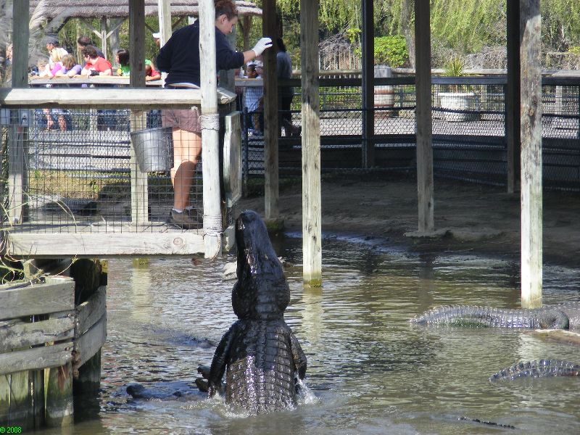
PATENT CHALLENGE OPTIONS ADDMG CLE 10/12

Slide 16
PATENT CHALLENGE OPTIONS ADDMG CLE 10/12
How to Decide Which, if Any, to Pursue?
Subject matter and timing
Let’s Get Rid of the Seldom Used Options
Covered Business Method Patent Review (Just like PGR in operation and fees)
any patent issued before 9/16/12, and program runs till 9/16/20
“a covered business method patent is a patent that claims a method or corresponding apparatus for performing data processing or other operations used in the practice, administration, or management of a financial product or service, except that the term does not include patents for technological inventions.”
Petitioner must be sued or charged with infringement

Slide 17
PATENT CHALLENGE OPTIONS ADDMG CLE 10/12
Let’s Get Rid of the Seldom Used (cont’d)
Derivation ($400)
Only a patent applicant may file, and within 1 yr of first publication (claim the same or substantially the same) as earlier application’s claim
Need basis that earlier inventor derived claimed invention

Slide 18
PATENT CHALLENGE OPTIONS ADDMG CLE 10/12
Timing for PGR and IPR
Time of filing
< 9 mos from (re)issue date – PGR (kicks in after 3/16/13)
> 9 mos from (re)issue date (or end of PGR) – IPR

Slide 19
PATENT CHALLENGE OPTIONS ADDMG CLE 10/12
Inter Parties Review (Date 9/16/12)
Who? – 3rd Party who has not filed an invalidity lawsuit and less than 1 year after service of infringement complaint, real party in interest
When? – Filed > 9 mos from (re)issue date (or end of PGR), all patents
What? – 3rd Party files a petition, only printed pubs and patents under 102 & 103, claim construction and how unpatentable, survive possible patentee response, PTO decides on “reasonable likelihood” (50/50), trial for each claim and each ground, patentee gets to amend at least once
How Long? – Completed within 1 yr, extendable for 6 mos.

Slide 20
PATENT CHALLENGE OPTIONS ADDMG CLE 10/12
Inter Parties Review (cont’d)
How Much? – Fee = $27,200 + $600 for each claim over 20
Patentee Considerations?
Can amend
Can Settle

Slide 21
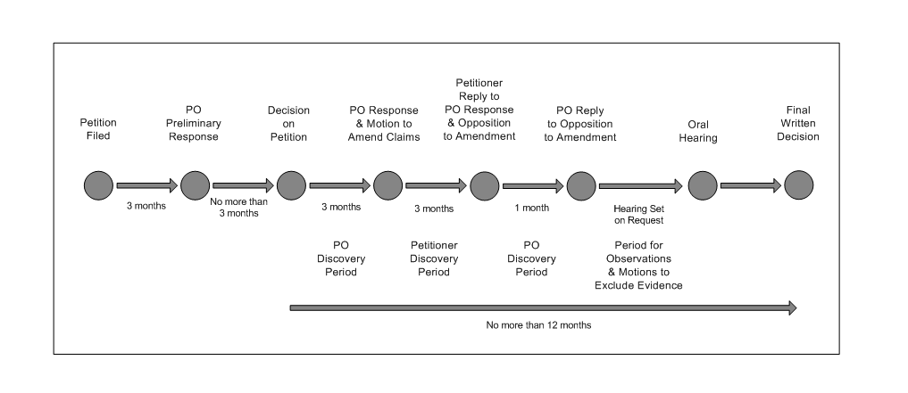
PATENT CHALLENGE OPTIONS ADDMG CLE 10/12

Slide 22
PATENT CHALLENGE OPTIONS ADDMG CLE 10/12
Inter Parties Review (cont’d)
Sequence of discovery
Patent Owner deposes Petitioner’s declarants
Patent Owner response and motion to amend claims, Petitioner deposes Patent Owner’s declarants
Petitioner files reply to PO response and opposition to amendment, PO deposes P’s declarants and files a reply
If PO relies upon new evidence for amendments, P goes another round
Motions to exclude evidence per FRCP

Slide 23
PATENT CHALLENGE OPTIONS ADDMG CLE 10/12
Inter Parties Review (cont’d)
3rd Party Considerations?
Can settle
Relatively expensive, but not compared to litigation
Most helpful with single troublesome patent (Pharma)
PTO estoppel? Yes, wrt any claim or ground that raised or “could have been raised”
Litigation estoppel? Yes, D.Ct. wrt any claim or ground raised or “could have been raised” (no sandbagging prior art, patents & printed pubs)
Very short time frames
Only 102 & 103 patent or printed pubs
Asking the PTO to admit that it made a mistake
Lead counsel must be a registered patent attorney

Slide 24
PATENT CHALLENGE OPTIONS ADDMG CLE 10/12
Post Grant Review (Date: 9/16/12)
Who? – 3rd Party who has not filed an invalidity lawsuit, real party in interest
When? – Filed < 9 mos from (re)issue date (patents issuing from first-inventor-to-file patents, i.e. 3/16/13)
What? – 3rd Party files a petition, not limited to printed pubs and patents, under 101, 102, 103 & 112, claim construction and how unpatentable, survive possible patentee response, PTO decides on “more likely than not” (>50%), trial for each claim and each ground, patentee gets to amend at least once
How Long? – Completed within 1 yr, extendable for 6 mos.

Slide 25
PATENT CHALLENGE OPTIONS ADDMG CLE 10/12
Post Grant Review (cont’d)
How Much? – Fee = $35,800 + $800 for each claim over 20
3rd Party Considerations?
Can settle
Relatively expensive
Most helpful with single troublesome patent (Pharma)
PTO estoppel? Yes, wrt any claim or ground that raised or “reasonably could have been raised”

Slide 26
PATENT CHALLENGE OPTIONS ADDMG CLE 10/12
Post Grant Review (cont’d)
3rd Party Considerations (cont’d)?
Litigation estoppel? Yes, for D. Ct., ITC wrt any claim or ground raised or “reasonably could have been raised” (no sandbagging prior art)
Very short time frames
Asking the PTO to admit that it made a mistake
Lead counsel must be a registered patent attorney
Need an elaborate patent monitoring program to make timing requirements
Exposure to willful infringement

Slide 27
PATENT CHALLENGE OPTIONS ADDMG CLE 10/12
Recommendations:
For Patentees
Emphasis still on selecting high quality invention disclosures, search and consider prior art in original drafting, add claims for US cases
Consider Supplemental Examination, rather than Ex Parte Reexam, to have art considered by PTO
Reissue also seems like a bargain and permits broader claims (2 yr)

Slide 28
PATENT CHALLENGE OPTIONS ADDMG CLE 10/12
Recommendations (cont’d):
For 3rd Party Patent Challengers
If you are a manufacturer, think long and hard about a monitoring program for competitors’ published applications and patents
Preissuance Submissions may have potential, but again you need a monitoring program, and we will need to see how much weight the PTO gives such submissions
Consider the risk/reward of hiring patent monitoring services
The litigation estoppels for PGR and IPR are likely show stoppers
END

